Slide 1




AITC COMP TRAINING
CYBER + NETWORKING

Slide 2
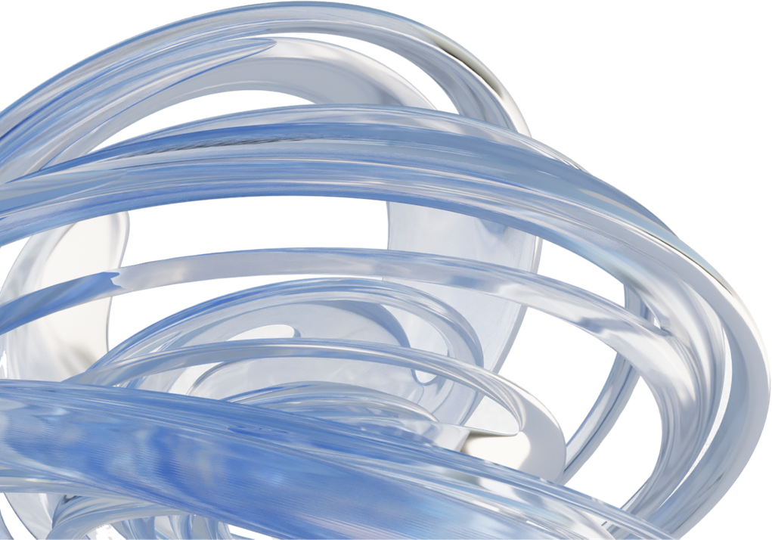
OBJECTIVES
Go over requirements for the AITC competetion for networking and cybersecurity.
Show an example of previous USITCC problem statements
Talk about preperation steps for a competition like this
Work through a practice problem for cyber.

Slide 3
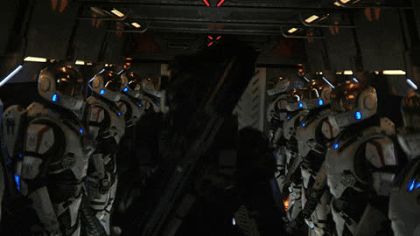
TIPS FOR SUCCESS
Plan before competition
How will we share files to work on the same doc? (networking)
Where are my resources for solving challenges? (cyber)
Who in my team is responsible for what?
Planning document
Diagram (Cisco is not collaborative, plan for this)
How will I take notes if required?
Pre-prepping templates might help
Prettiness counts, CISOs like pretty diagrams
In competition tips
Have milestones, time management is important. Get stuck? move on.

Slide 4
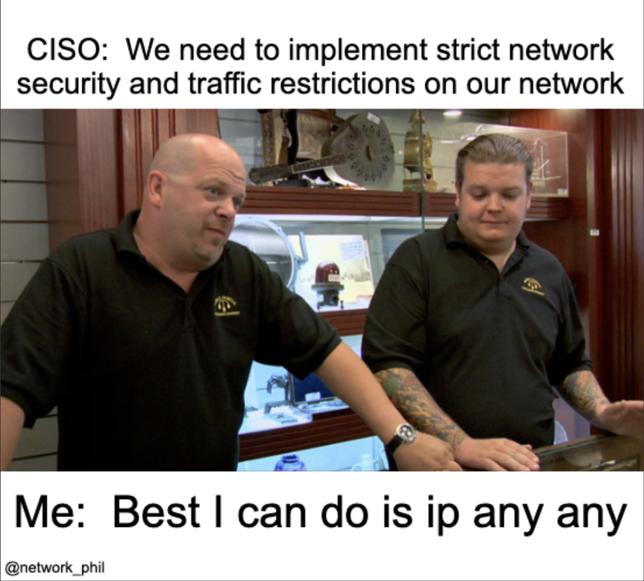
NETWORK
NEXUS
Creating an enterprise grade network

Slide 5

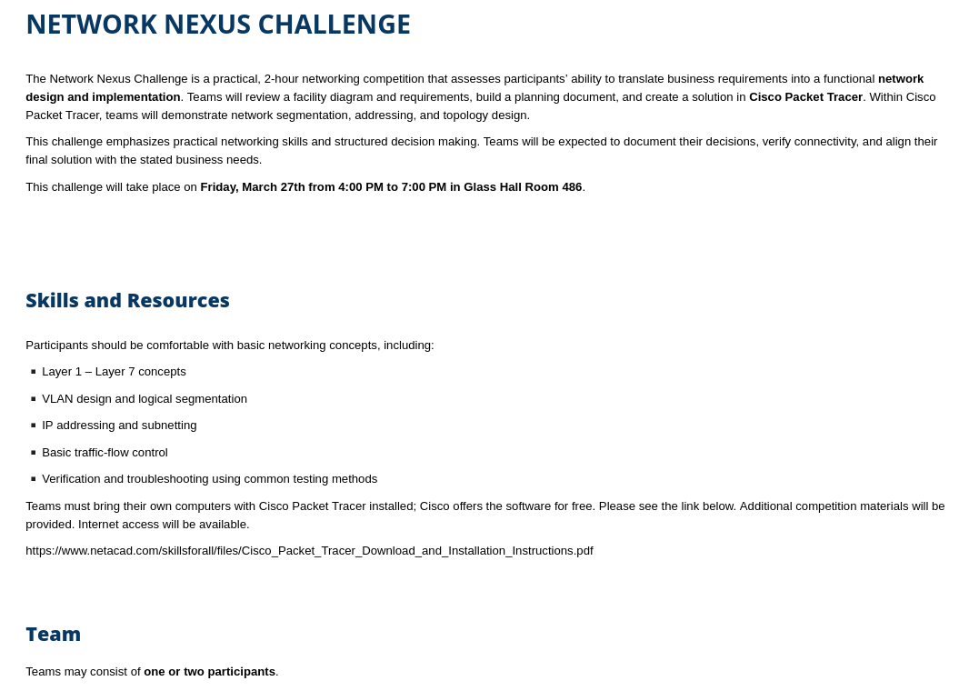

Slide 6
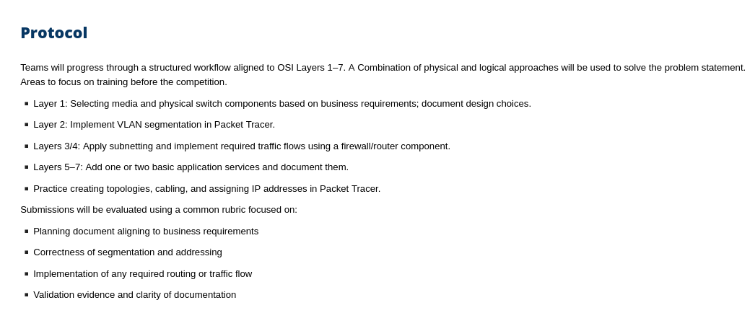

Slide 7
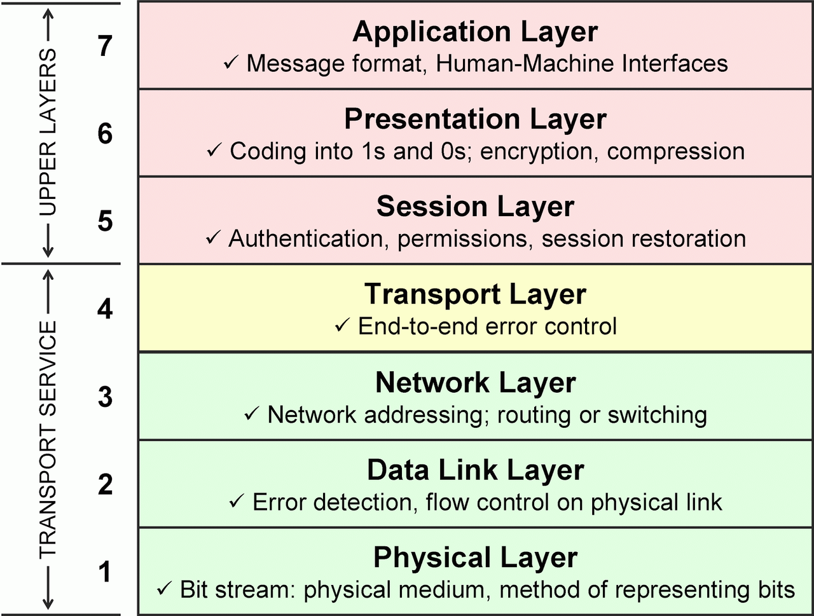
OSI MODEL

Slide 8
EXAMPLE PROBLEM
STATEMENT
https://tinyurl.com/usitccnetwork2023
The following slides have an example problem statement from USITCC 2023.
Based on the rules we will likely see a much more simple stament for AITCC
Backup link:
https://livemissouristate-my.sharepoint.com/:b:/g/personal/to329s_login_missouristate_edu/IQBC2K0oi0EWTZV_iRS0OyIhARE79vd62z5RKVJuAJrbcVE?e=KbSMye

Slide 9
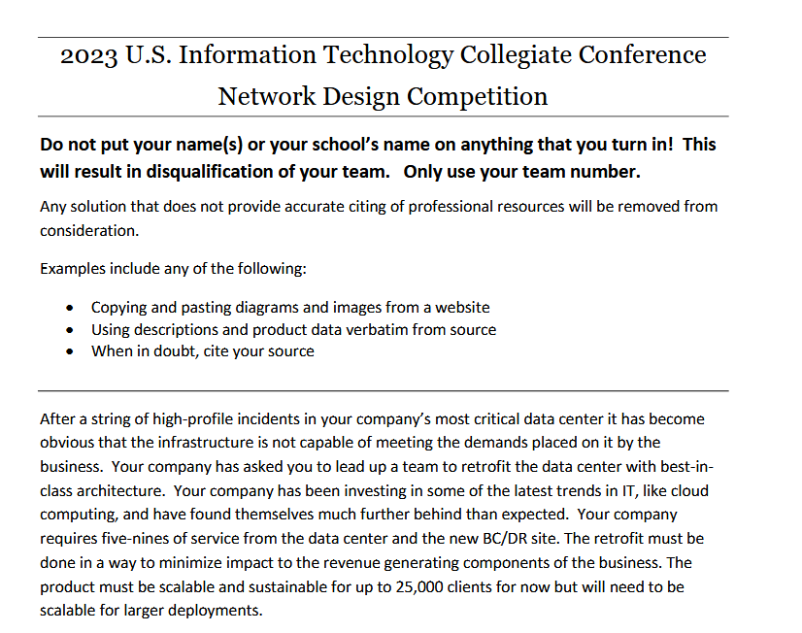
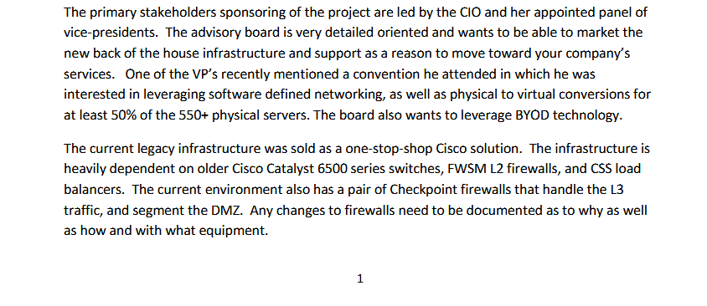
EXAMPLE PROBLEM
STATEMENT

Slide 10
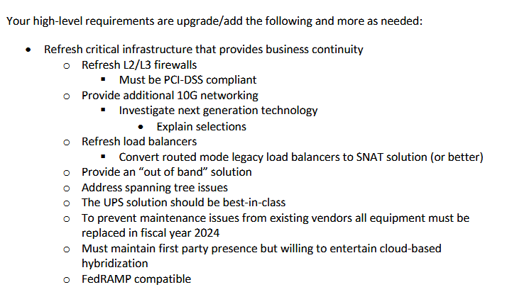
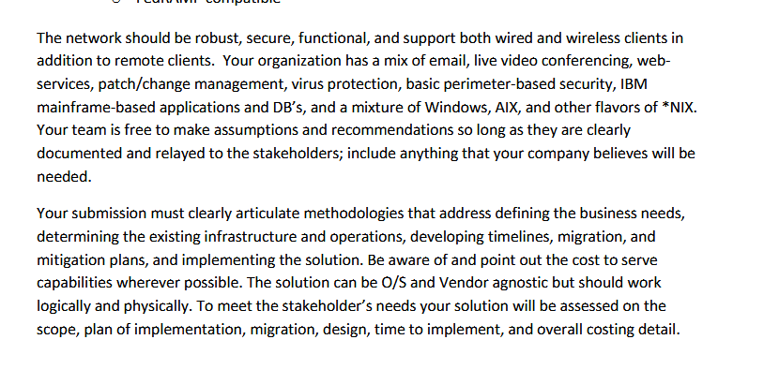
EXAMPLE PROBLEM
STATEMENT

Slide 11
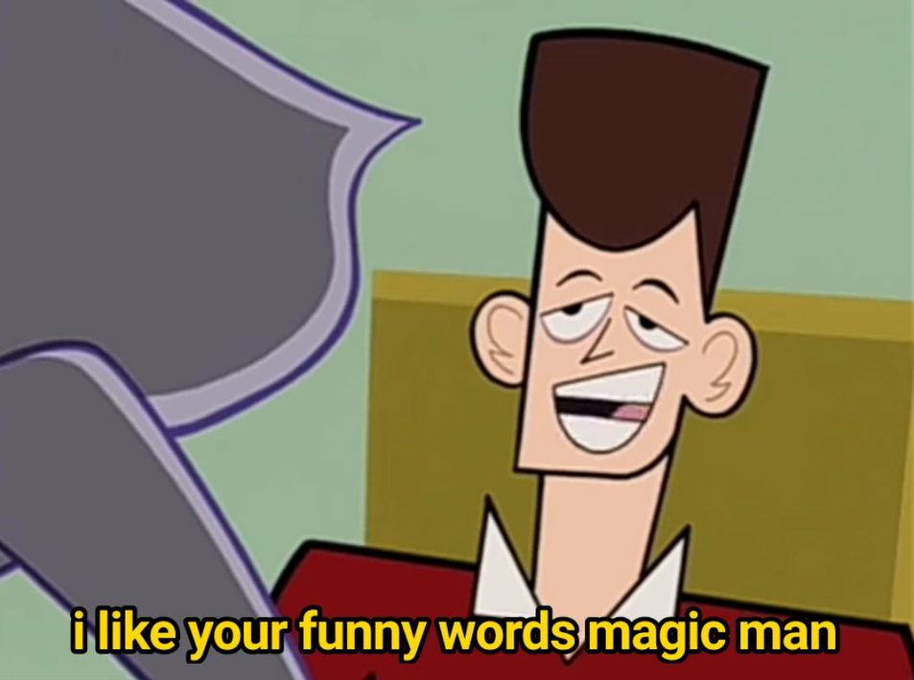
NOTES OVER PROBLEM STATEMENT
Google is fair game, look the technologies you don’t know.
Many of those requirements I couldn’t define off the top of my head
Tech jargon is very common in IT. Different names for the same thing depending on vendor.
This includes networking tools! (it-tools.tech)
Focus on the biggest part of this getting a deliverable
you can integrate the requirements later.

Slide 12
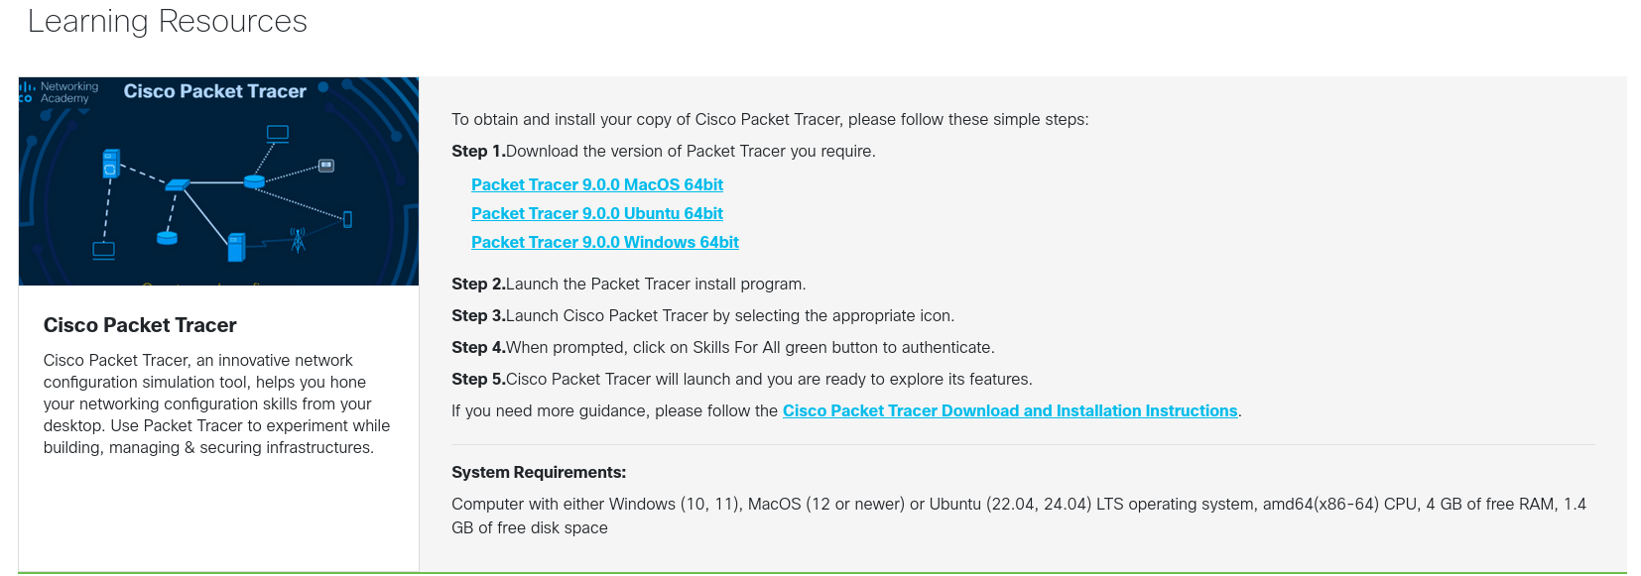
DOWNLOAD PACKET
TRACER
Pre-installed on 388 computers
https://tinyurl.com/msupacket-tracer

Slide 13
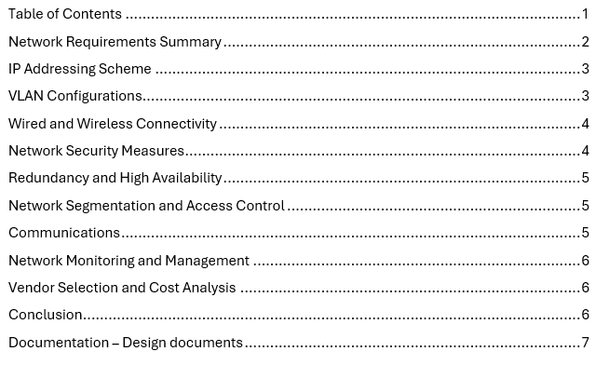
EXAMPLE TABLE OF CONTENTS
Depends on what deliverables are required for the new competition.
Take a look back at the original rules, will seem likely to be different
Example: My sophmore report

Slide 14
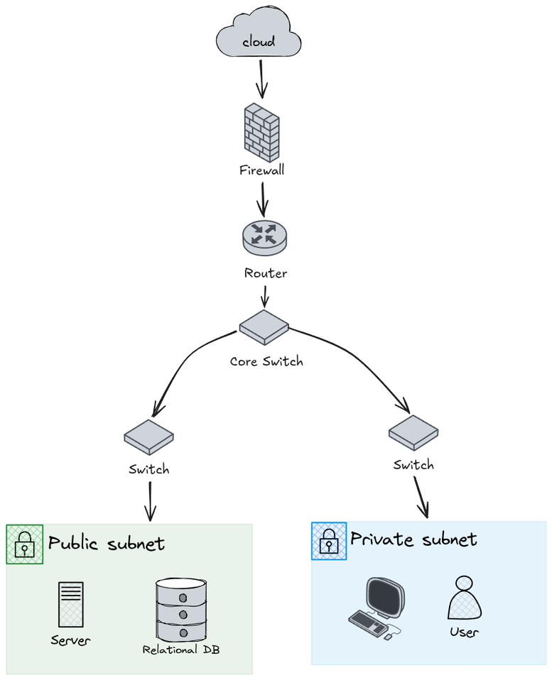
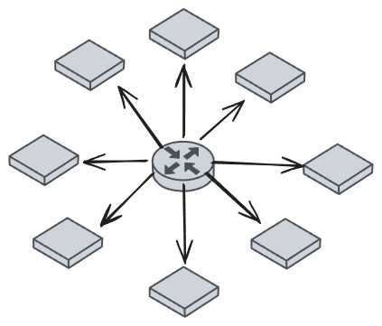
Topologies
Hub and spoke
Tree

Slide 15
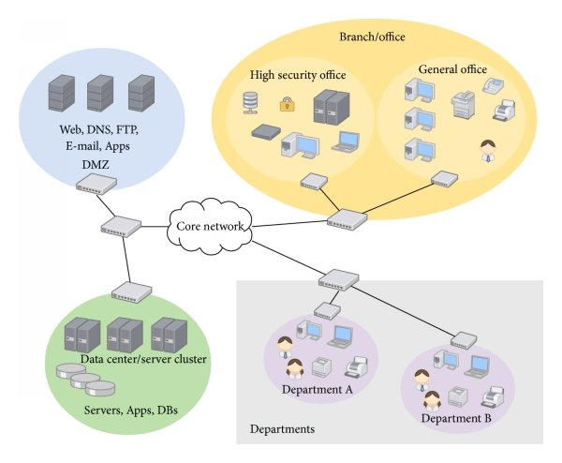
Credit: researchgate.net

Slide 16
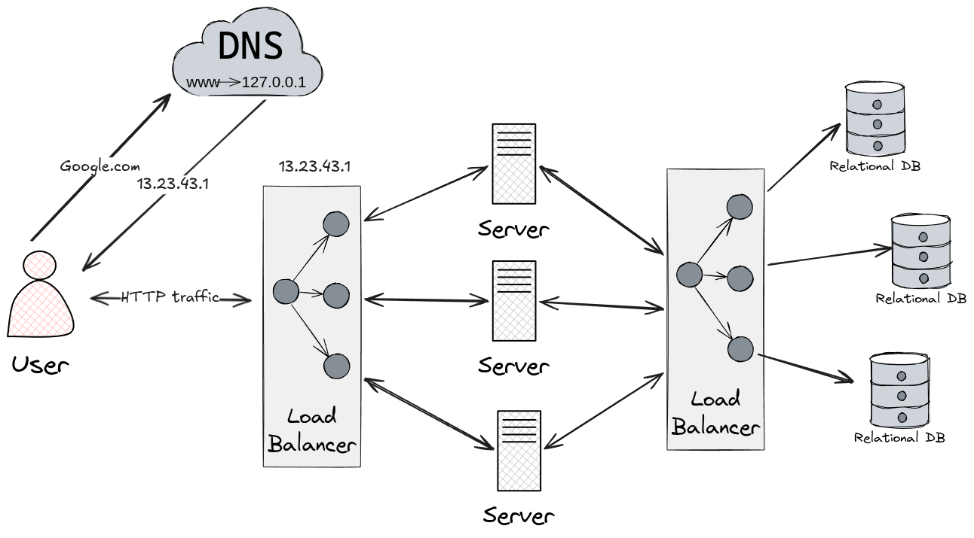
Load balancing is everywhere

Slide 17
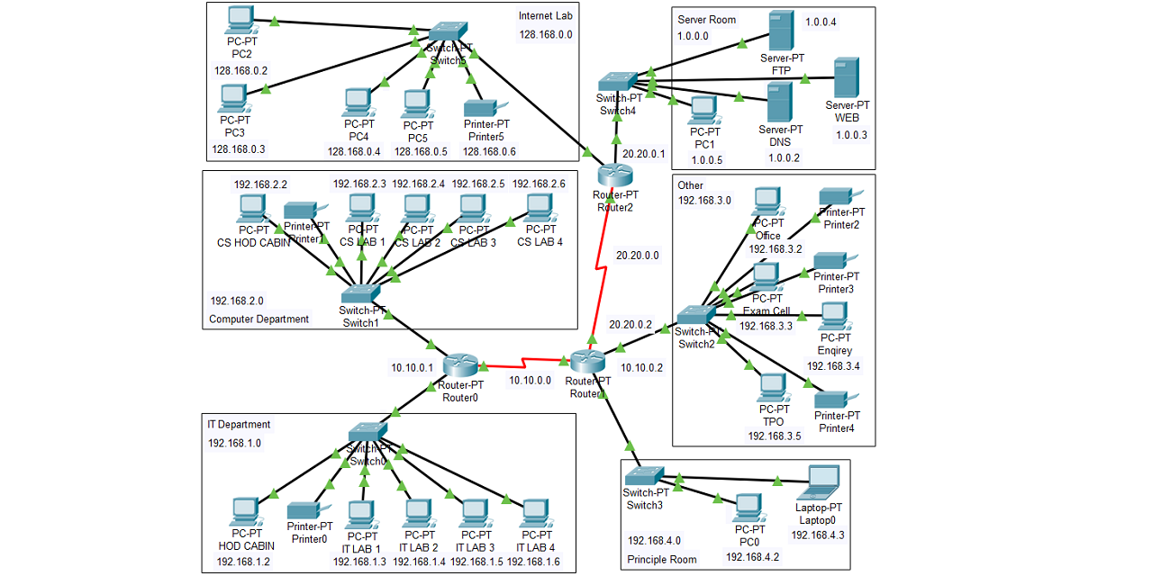
Final PRoduct

Slide 18

EXAMPLE STEPS
Planning Document
Final Product
IP Addressing / Subnetting
How will you address requirements?
Documentation of your process. What steps are you taking?
Use simple terms (students have best perspective here!)
Hopefully functional* (If you run out of time, make it work
Make it readable, avoid having a massive mess

Slide 19
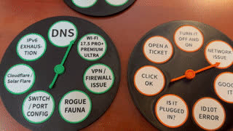
ADDITIONAL
STUDY
Cisco Net Academy
“Example Enterprise Topologies”
Review essential networking concepts
Create example topologies in packet tracer, have an idea of what you will want in there
Look into technologies modern organizations use: cloud services, and networking tech. You’ll have limited time, but get modern tech in there

Slide 20
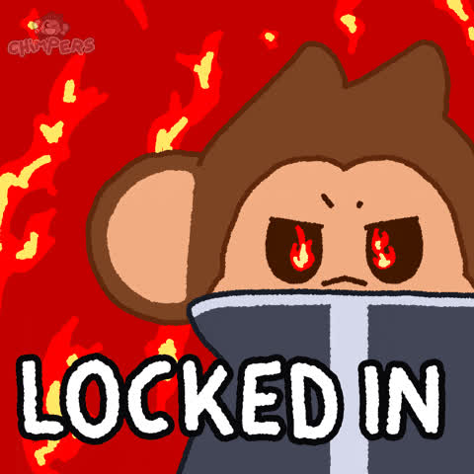
CYBER SENTINEL
Hack the Box CTF Challenge

Slide 21
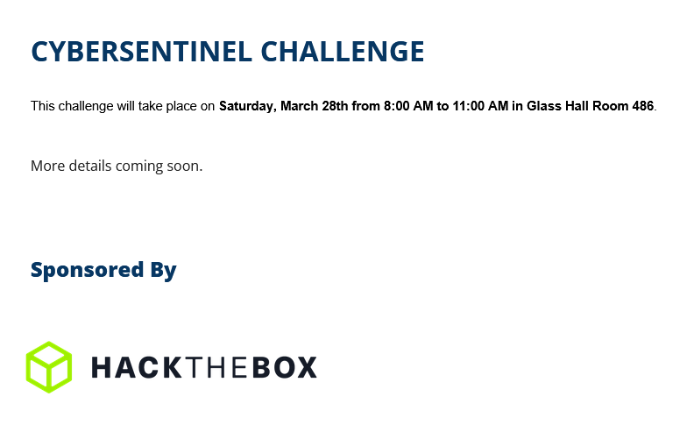
GOING OVER COMP RULES
Thats it.
This is most of the skills we have gone over so far review the github
I believe most likely categories:
Web
Pwn
Forensics
Cryptography
Coding?

Slide 22
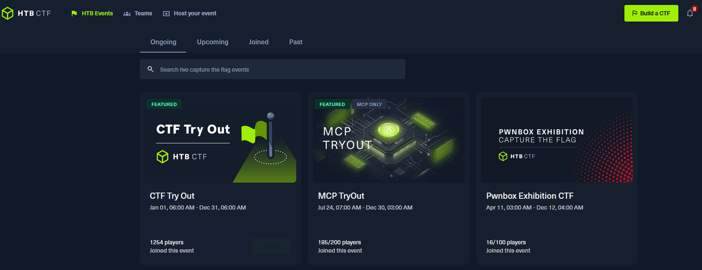
LAB: CTF TRYOUT

Slide 23
JAILBREAK
Q1
Q2
Q3
Enumerate Website Whats there?
Is there any way we can insert data?
Test santization, Learn a bit about XML and web
Execute the payload

Slide 24
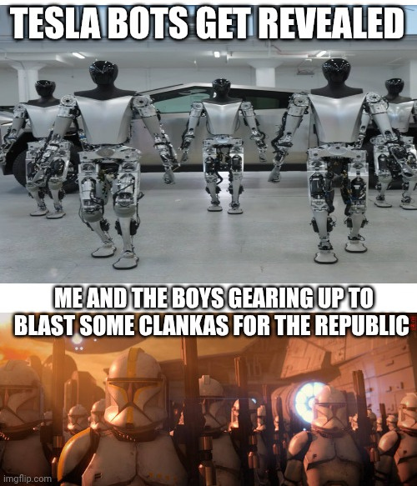
MY ADVICE
Know what tools you will use
You can use my tool list! (See github)
Take notes to help you with the analysis of the challenge, it might help you discover something you didn’t consider.
If you have a specialty use it! Go for those hard challenges.
In the end, you learned something.

Slide 25

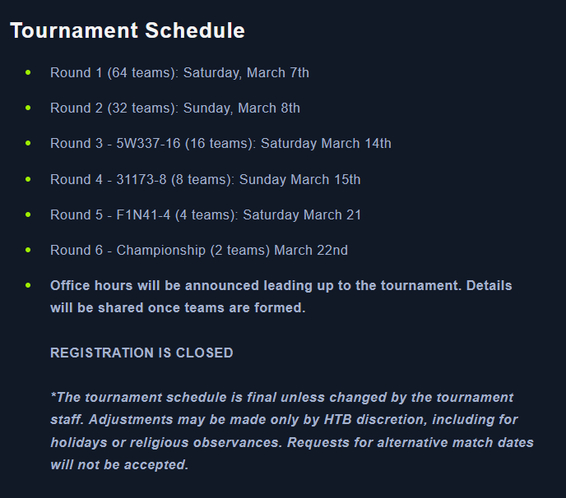
HACK THE MADNESS
March 6th Saturday

Slide 26
HACK THE MADNESS
March 6th Saturday
Register for ctf.hackthebox.com
Request to join (Make sure to send your username to to329s@missouristate.edu)

Slide 27
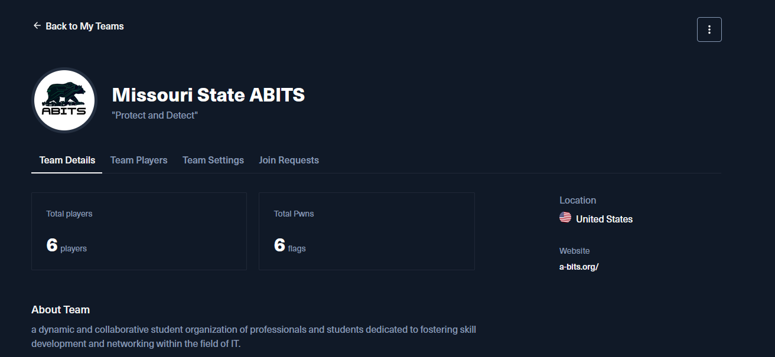
HACK THE MADNESS
March 6th Saturday
https://ctf.hackthebox.com/team/overview/196551

Slide 28

HACK THE MADNESS
March 6th Saturday
https://discord.gg/xWh9M3tMbd

Slide 29
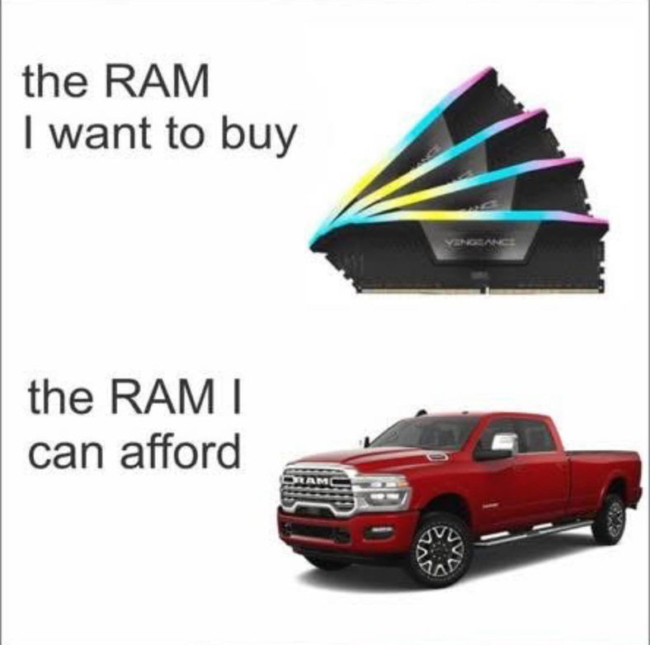
THANK YOU

